Slide 1
Introduction to Marketing Model Validation
September 27, 2023
Boan Zhang
Corporate Model Risk, Wells Fargo

Slide 2
Agenda
Overview of Marketing Models 03
Marketing Model Validation 05
Challenges 07
Common Performance Metrics 08
Explain-ability and Benchmark Analysis 11

Slide 3
Overview of Marketing Models
Marketing model
Business portfolio: Mortgage, consumer credit card, small business checking, personal loan, deposit products, etc.
Marketing channel: Direct mail, email, digital/omni-channel, affiliates/third-party, multi-channel, etc.
Target population: Current customers or potential customers
Model Types
For binary response marketing models, the typical outcome is binary, e.g., 1 = response and 0 = no response – GBM, logistic regression, decision tree, etc.
Other marketing models: balance/profit models; marketing optimization models for budget allocation to max profit or new acquisitions – GBM, regression models, optimization methods

Slide 4
Overview of Marketing Models
Model Inputs
Customer profile, transaction activities, credit bureau data, digital engagements
Model predictions
Scores/probabilities/segments that rank order likelihood of customers responding to marketing campaigns
Customers within the top deciles/segments are usually targeted in future campaigns or presented with marketing messages
Risk
Decreased marketing efficacy
Reputational risk and regulatory risk (e.g., legal and compliance risk)
Cause: Non-traditional data, non-interpretable models

Slide 5
Marketing Model Validation
Data
Are the data/inputs appropriate/reliable?
Are the data sources appropriate/reliable/up-to-date?
Model Performance
Is the model performance acceptable/reliable?
Model benchmarking: How the model performs compared to different benchmarks?
Explain-ability
How can we explain/interpret the model behavior
How the model makes its decisions?
Model Fairness
Is the model fair to different groups in the data?
Is the model treating different sub-populations of the data similarly?
Model performance on different segments of data
What is the relation of the model output to each of the input features?
How sensitive is the model to each of the input features?
How the model performance changes over-time?
Are the model inputs reliable?
Do the feature engineering steps make sense?
Are there any protected variables in the feature set?

Slide 6
Marketing Model Validation: Testing
Data
Are the data/inputs appropriate/reliable?
Histograms
Model Performance
Is the model performance acceptable/reliable?
Explain-ability
How can we explain/interpret the model behavior
Partial Dependence Plots (PDPs)
Model Fairness
Is the model fair to different groups in the data?
Model Performance on different segments of the population
AUC, KS, ROC, Gain, Lift (Binary outcome)
Outlier Detection
Analysis of Missing Values
Model vs. benchmarks
Performance overtime
Performance on different segments of data
VIFs
SHAP, LIME
Perturbation-based sensitivity analysis

Slide 7
Challenges
Challenges
Marketing datasets are often imbalanced.
E.g., after sending a marketing offer to 1000 customers, what if only 20 respond?
We will get a data set with binary response where 98% of observations are in negative class.
How to measure the marketing effect?
Treatment/Control group
Causal inference methods (PSM, Meta-learner, etc.)
Performance Metrics
Model vs no-model: Gains and LIFT
KS, AUC (rank ordering)

Slide 8
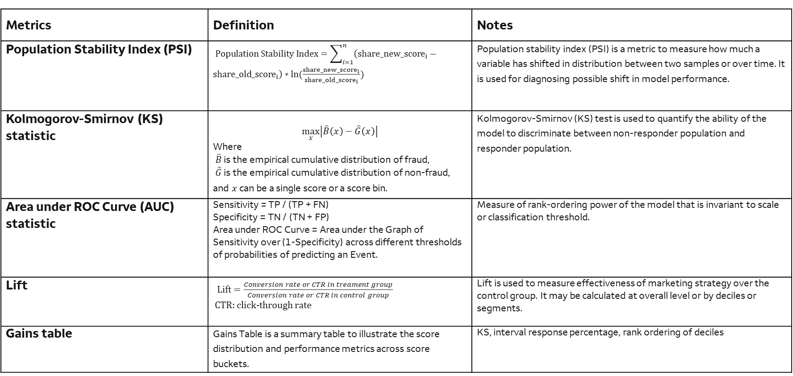
Common Performance Metrics for Marketing Models
Metrics | Definition | Notes
Population Stability Index (PSI) | $Population Stability Index=\sum_{i=1}^{n}{\left(share_{new_score}_{i}−share_{old_score}_{i}\right)∗ln⁡(\frac{share_{new_score}_{i}}{share_{old_score}_{i}}})$ | Population stability index (PSI) is a metric to measure how much a variable has shifted in distribution between two samples or over time. It is used for diagnosing possible shift in model performance.
Kolmogorov-Smirnov (KS) statistic | $$\max_{x}\left|\hat{B}\left(x\right)−\hat{G}\left(x\right)\right|$$ Where $\hat{B}$ is the empirical cumulative distribution of fraud, $\hat{G}$ is the empirical cumulative distribution of non-fraud, and $x$can be a single score or a score bin. | Kolmogorov-Smirnov (KS) test is used to quantify the ability of the model to discriminate between non-responder population and responder population.
Area under ROC Curve (AUC) statistic | Sensitivity = TP / (TP + FN) Specificity = TN / (TN + FP) Area under ROC Curve = Area under the Graph of Sensitivity over (1-Specificity) across different thresholds of probabilities of predicting an Event. | Measure of rank-ordering power of the model that is invariant to scale or classification threshold.
Lift | $Lift=\frac{Conversion rate or CTR in treament group}{Conversion rate or CTR in control group}$ CTR: click-through rate | Lift is used to measure effectiveness of marketing strategy over the control group. It may be calculated at overall level or by deciles or segments.
Gains table | Gains Table is a summary table to illustrate the score distribution and performance metrics across score buckets. | KS, interval response percentage, rank ordering of deciles

Slide 9
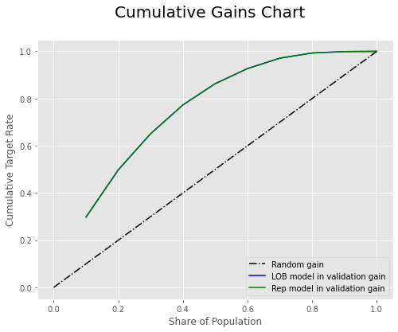
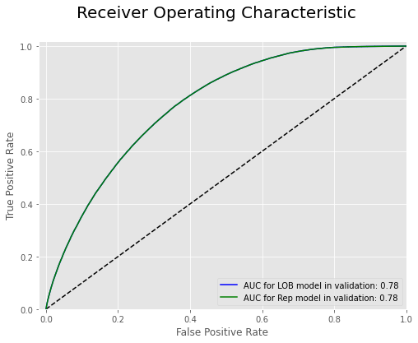
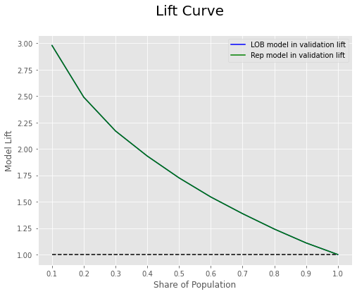
Performance Metrics for Marketing Models
KS stat for the original model in validation is: 41.41 AUC for the original model in validation is: 0.778 Gini for the original model in validation is: 0.556

Slide 10
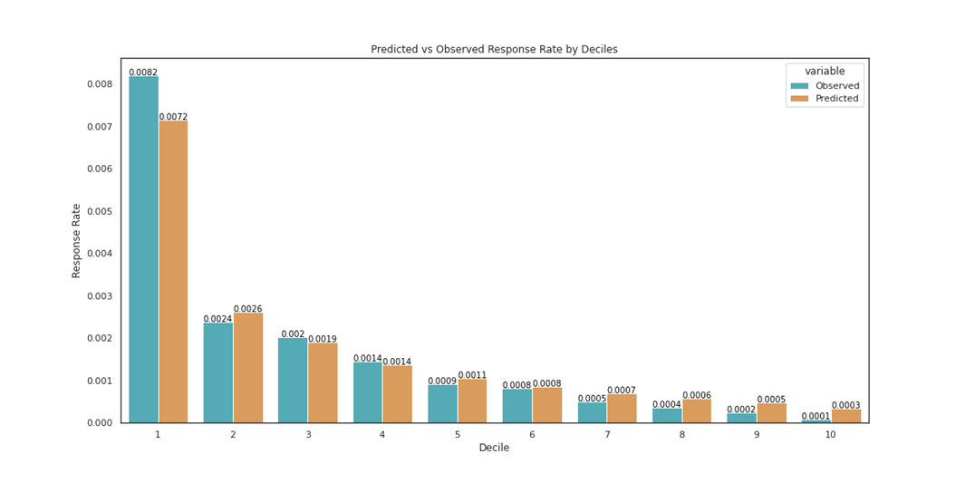
Performance Metrics for Marketing Models
Response rates by decile

Slide 11
Explain-ability of Marketing Models and Benchmark Analysis
If AI/ML models are used, typically they should also include model explain-ability.
Global importance tools such as variable importance, PDP, ICE, etc.
Local importance tools such as LIME and SHAP
Sensitivity analysis should also be required. Examples:
For final input variables, replace its value with a randomly generated value while keeping other variables unchanged, and see how model output or performance changes.
For top variables, replace its value with min/max value while keeping other variables unchanged, and see how model output changes.
Change the modeling parameters/vendor software setting and see how model output changes.
Benchmark models may be built
Simpler and more interpretable models with similar performance
More complex models with better performance

Slide 12
Questions?

